Slide 1
Рекуррентные нейронные сети

Slide 2
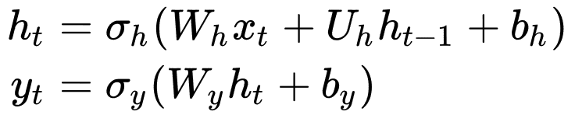
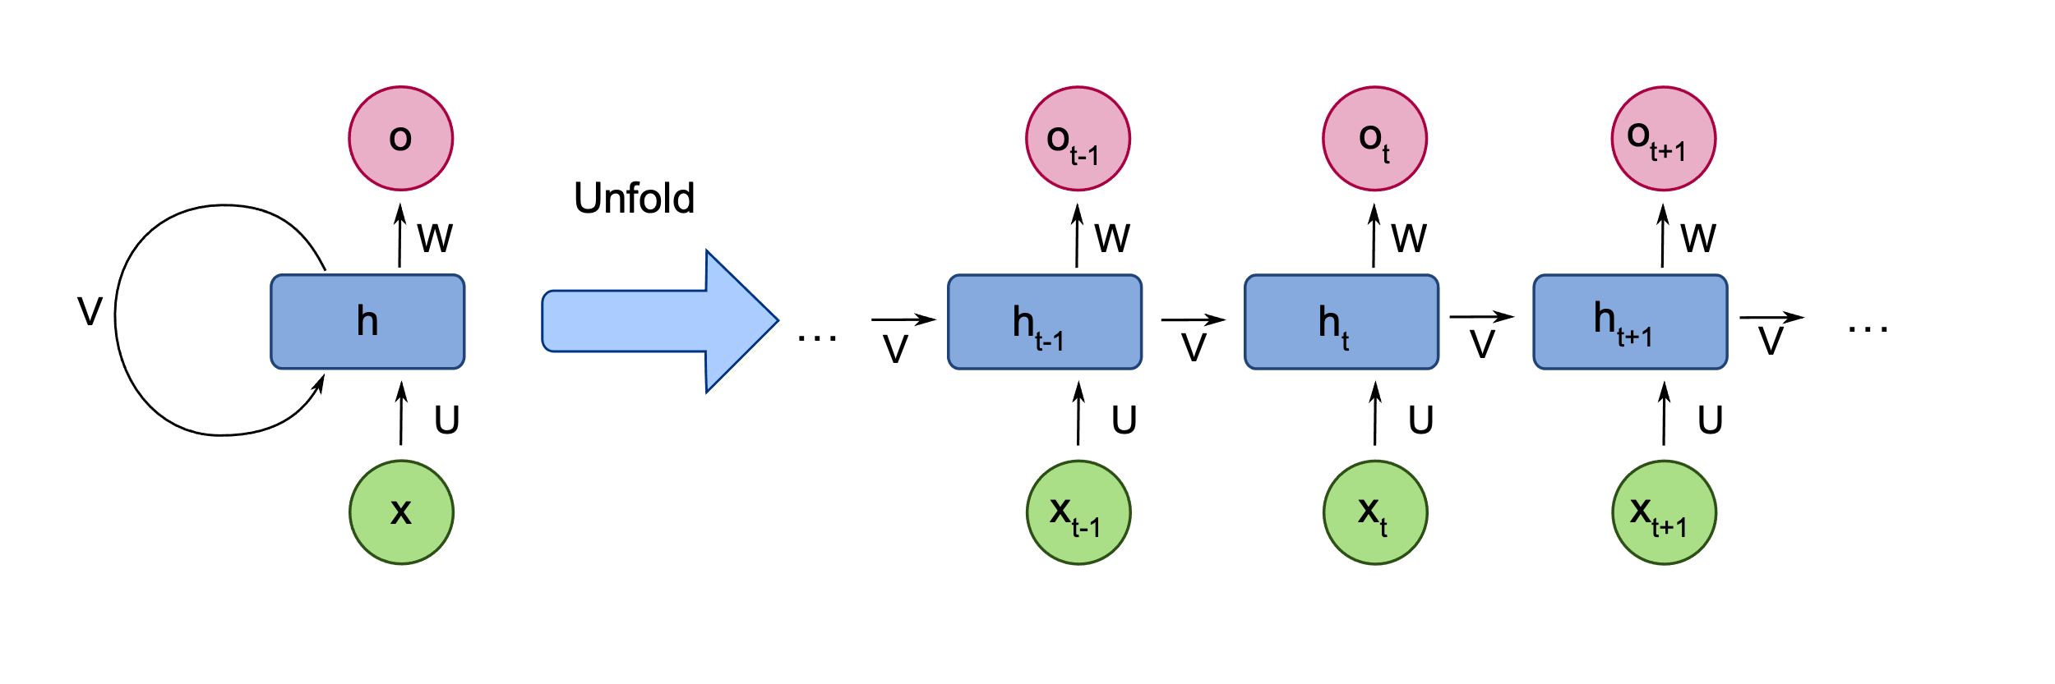

Определение
$$y_{t}, h_{t}=f(x_{t},h_{t−1})$$

Slide 3
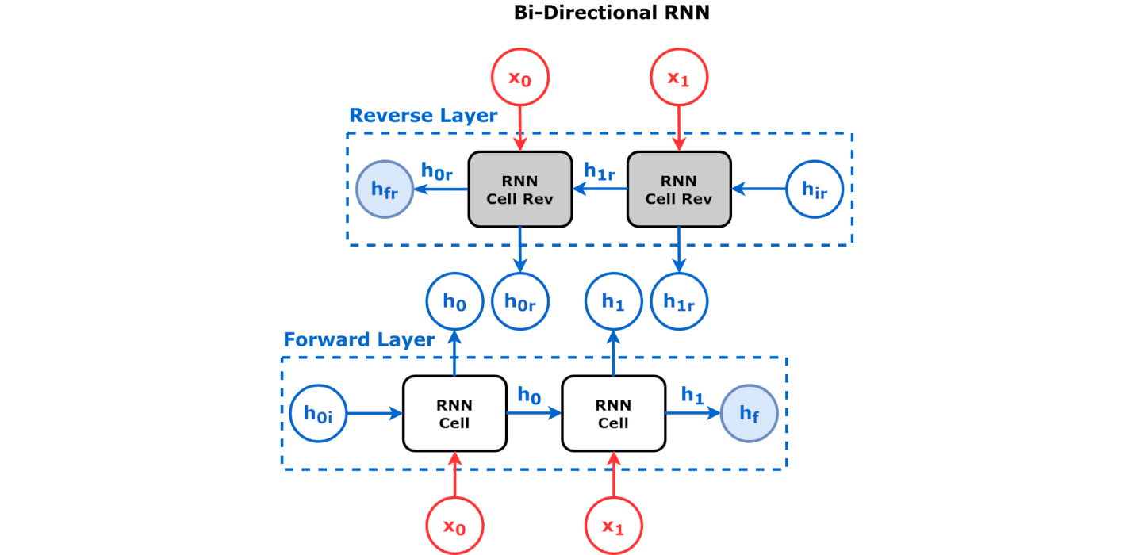
Двунаправленная рекурсия

Slide 4
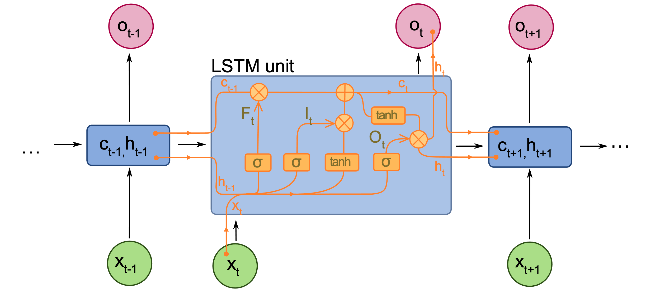
LSTM (Long-Short Term Memory)
Hochreiter, Sepp, and Jürgen Schmidhuber. "Long short-term memory." Neural computation 9.8 (1997): 1735-1780.

Slide 5
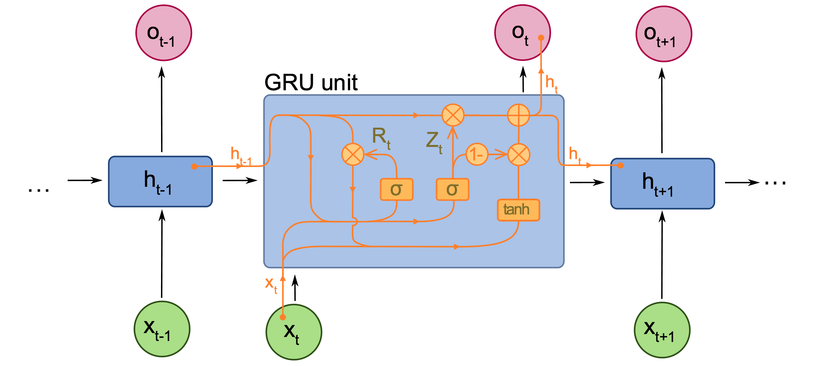
GRU (Gated Recurent Unit)
Cho, Kyunghyun, et al. "Learning phrase representations using RNN encoder-decoder for statistical machine translation.”
arXiv preprint arXiv:1406.1078 (2014).

Slide 6
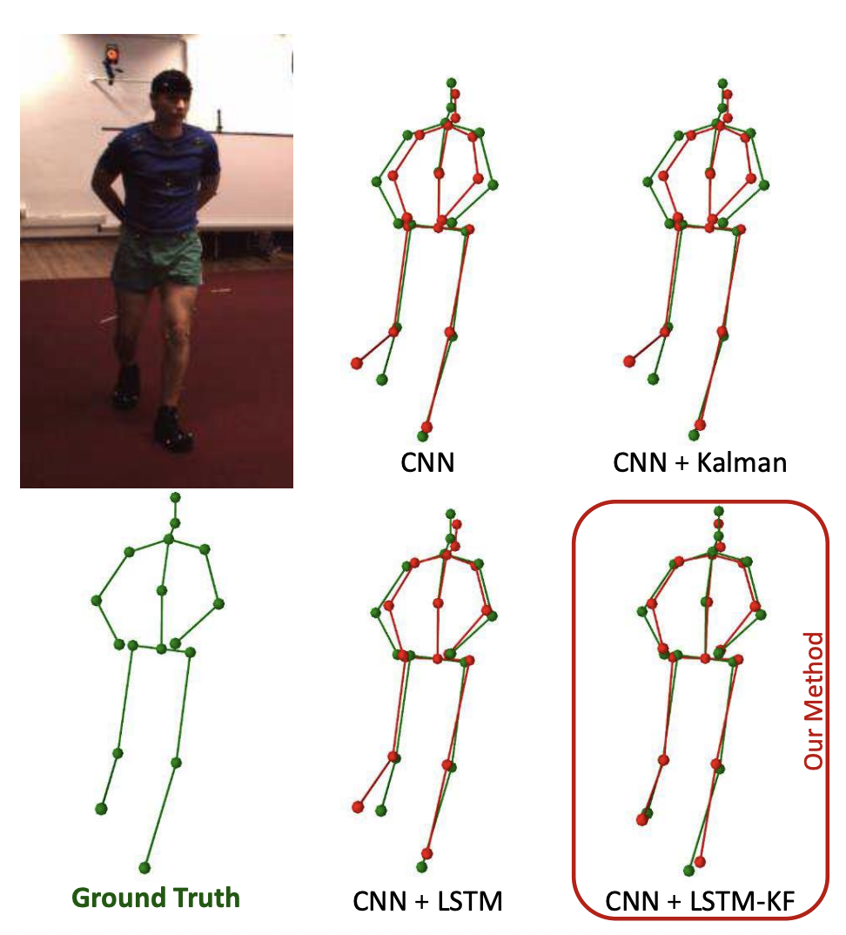
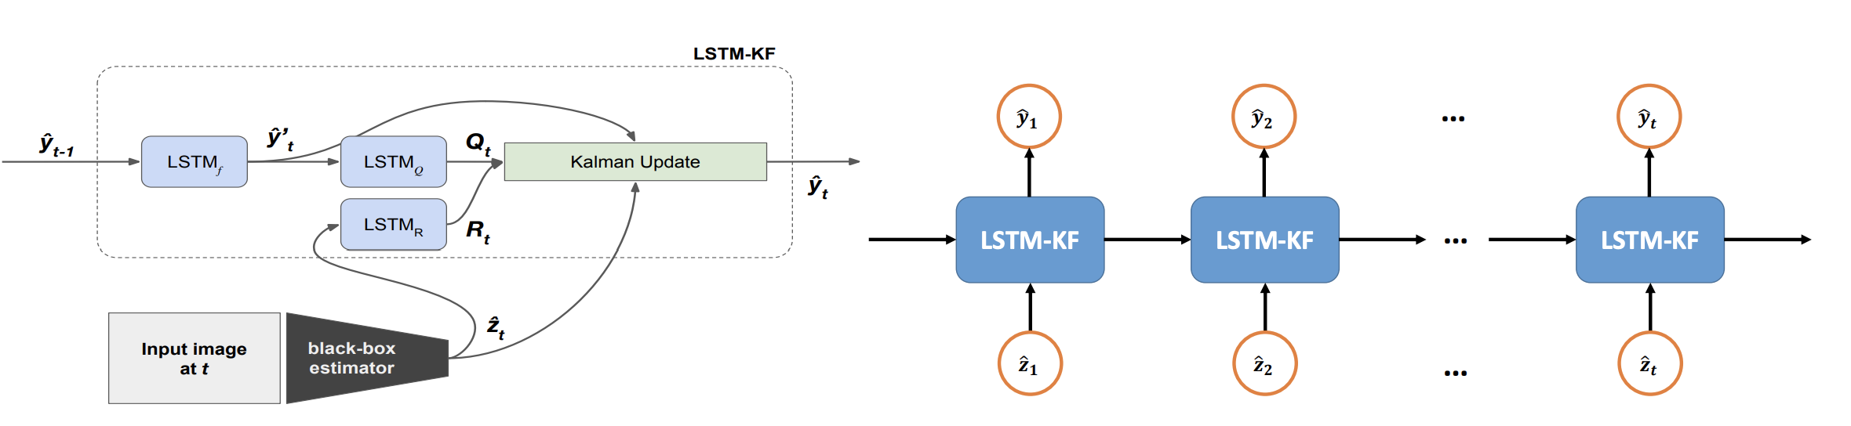
Улучшение позиции особых точек
Coskun, Huseyin, et al. "Long short-term memory kalman filters: Recurrent neural estimators for pose regularization." Proceedings of the IEEE International Conference on Computer Vision. 2017.

Slide 7
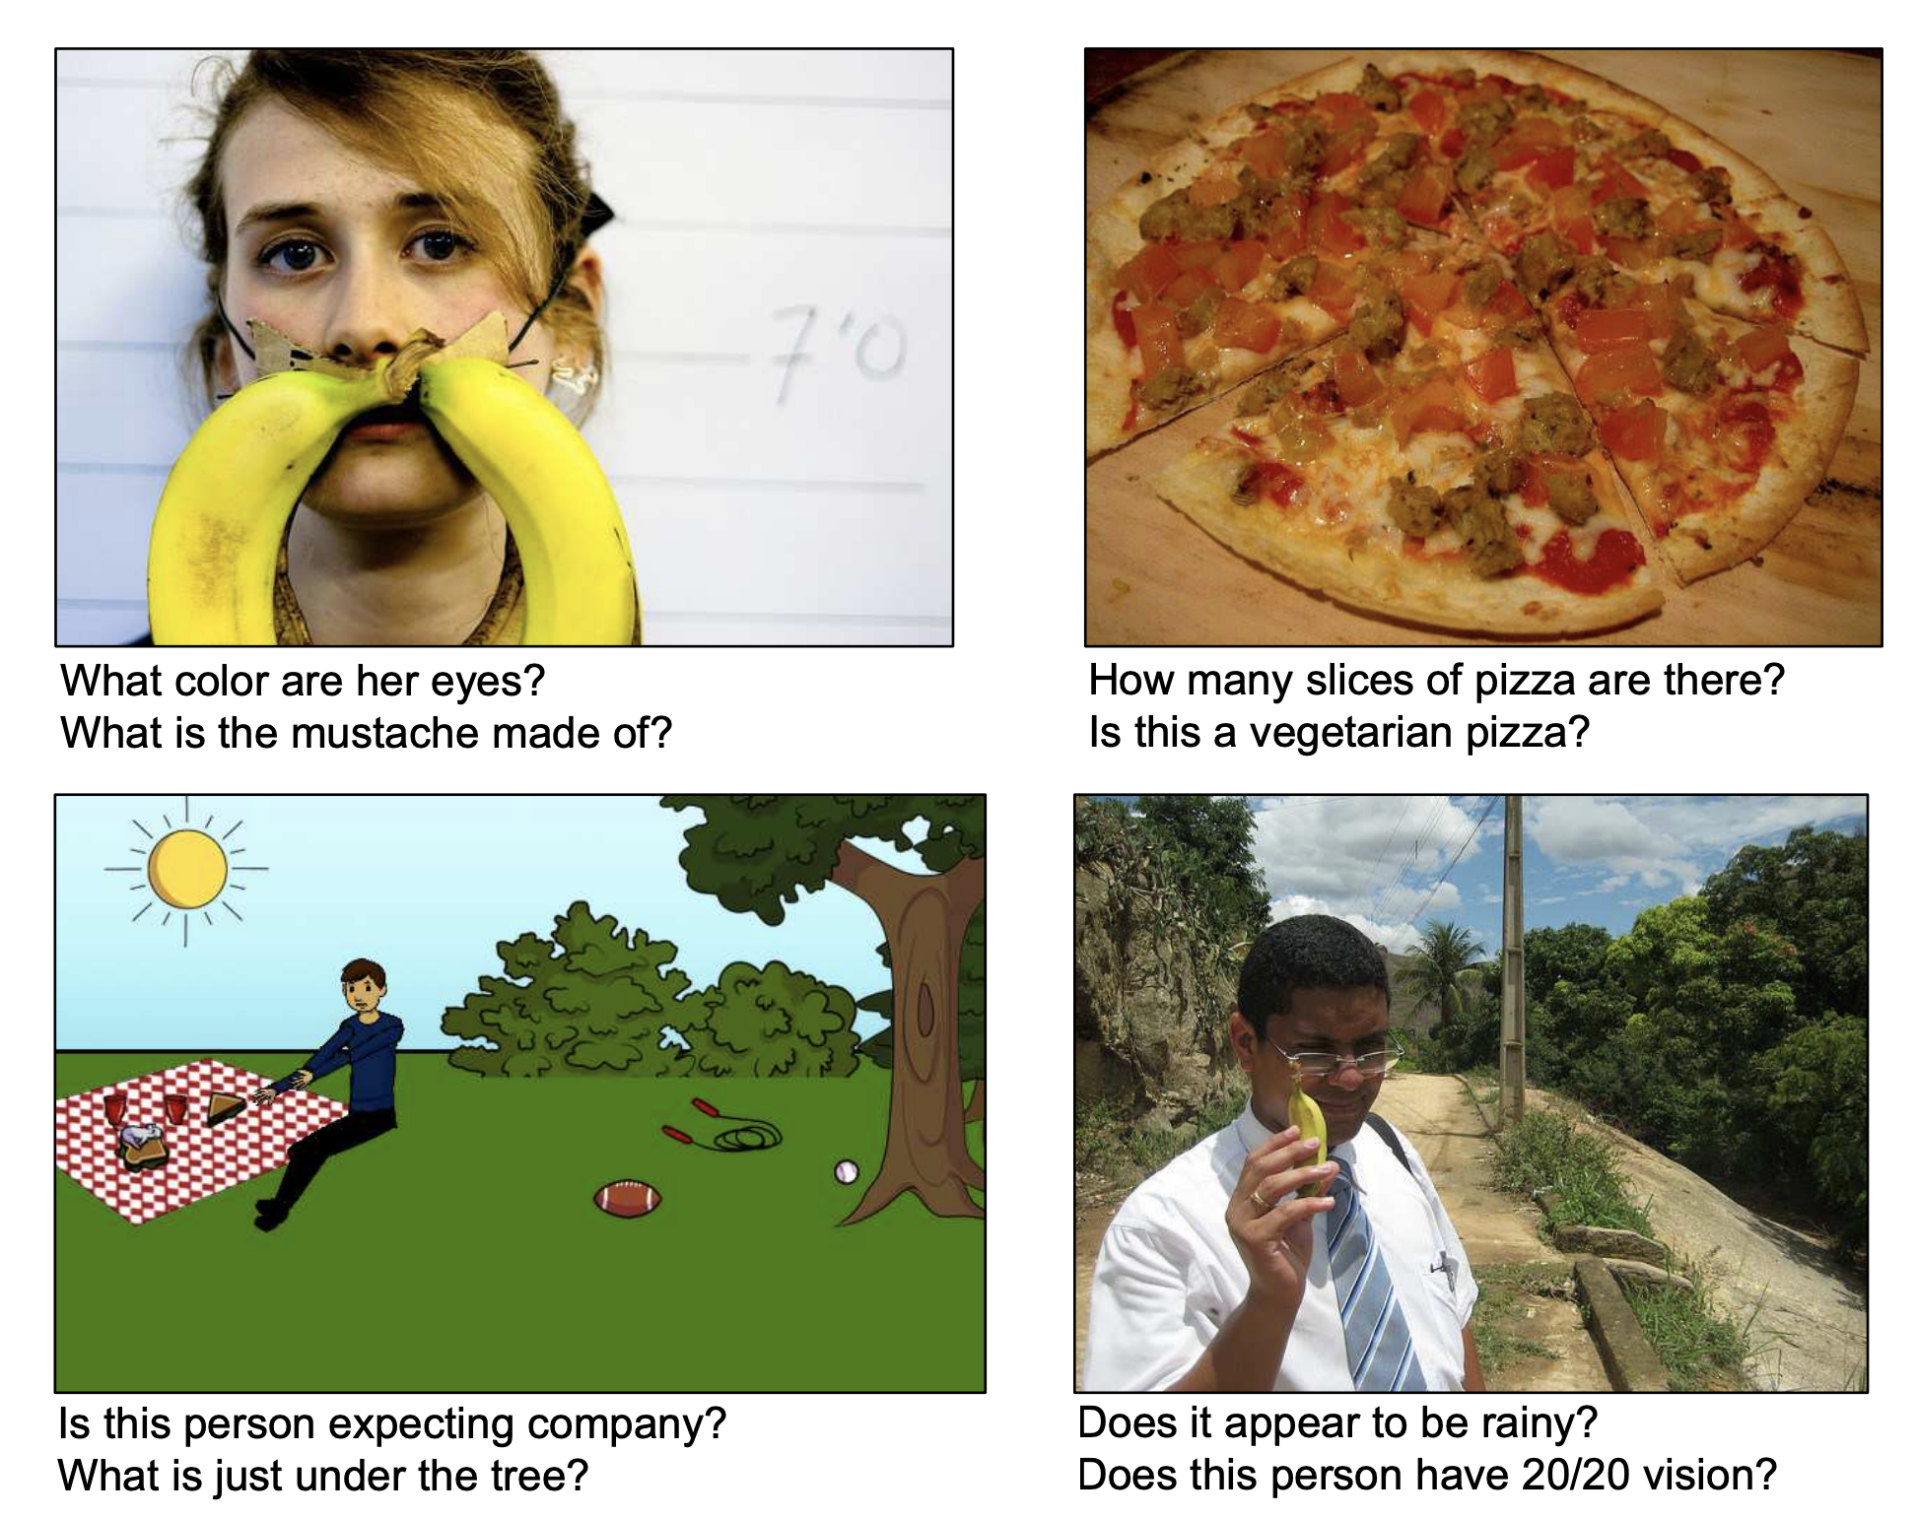
Visual Question Answering
Antol, Stanislaw, et al. "Vqa: Visual question answering." Proceedings of the IEEE international conference on computer vision. 2015.

Slide 8
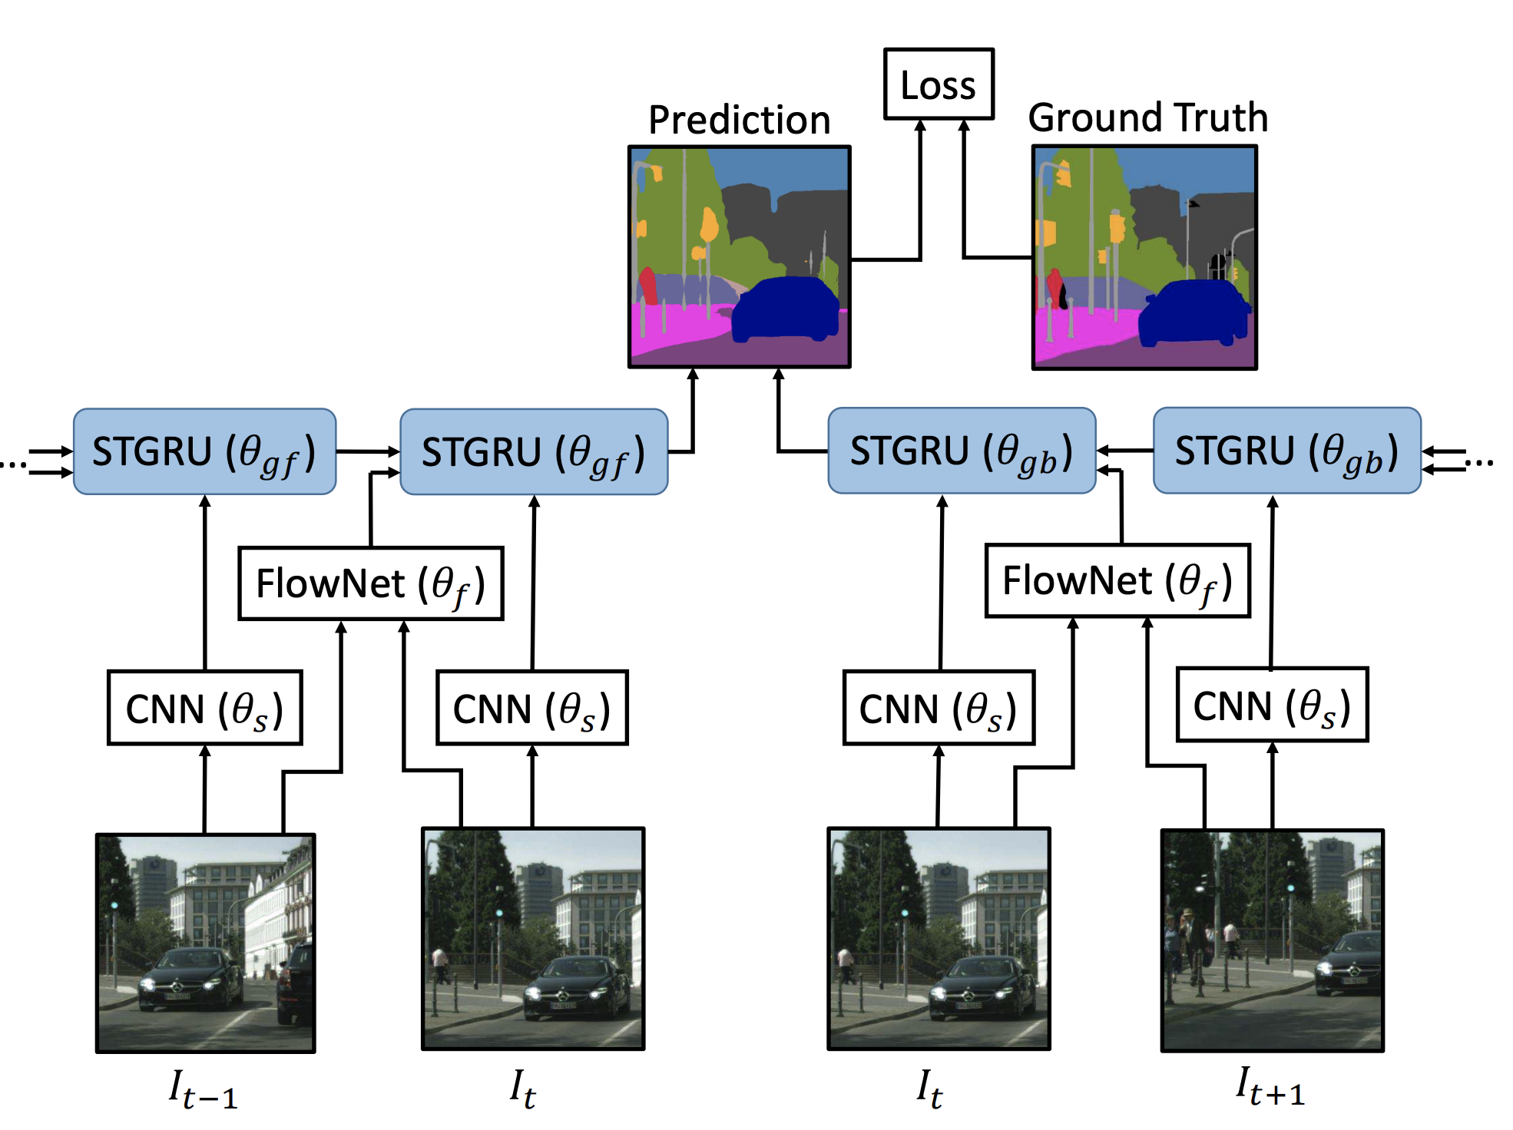
Сегментация методом сканирующего окна
Nilsson, David, and Cristian Sminchisescu. "Semantic video segmentation by gated recurrent flow propagation." Proceedings of the IEEE conference on computer vision and pattern recognition. 2018.

Slide 9
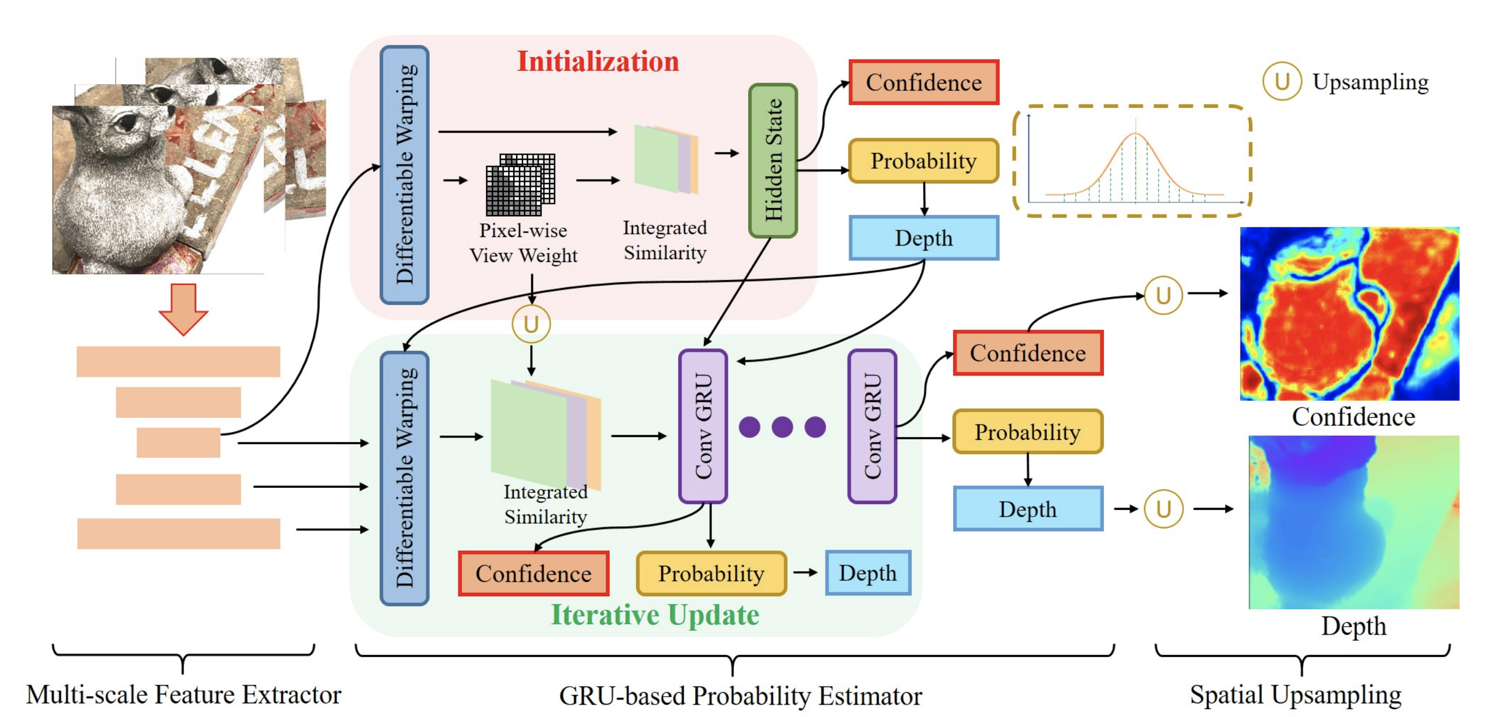
Многоракурсное стерео
Wang, Fangjinhua, et al. "Itermvs: Iterative probability estimation for efficient multi-view stereo." Proceedings of the IEEE/CVF conference on computer vision and pattern recognition. 2022.

